Slide 1





HESSIAN CORNER DETECTION
Presented by Rithani S

Slide 2
WHAT IS THE NEED TO DETECT A CORNER?

Slide 3
APPROACH FOR IMAGE MATCHING
(1)Find distinctive key points from given images.
(2) Define a local region around each keypoint.
(3) Extract and normalize the region content.
(4) Compute a local descriptor for each normalized region using pixel information (i.e. gradient orientation, magnitude).
(5) Match the local descriptors between images.

Slide 4
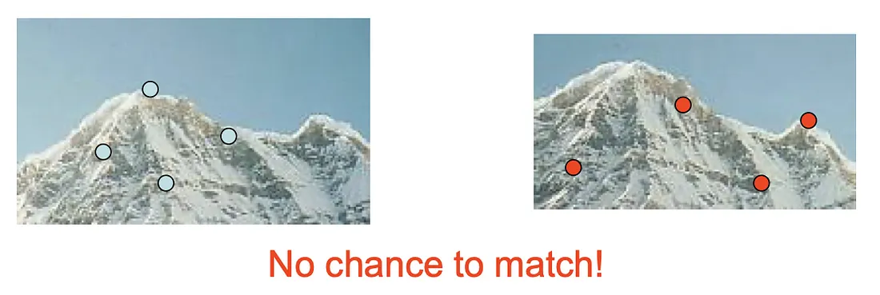
PROBLEM
The defined local feature descriptors have two requirements to meet in order to successfully do their job.
The descriptor should detect the same keypoint independently in both images
For each point from one image, the descriptor should produce a reliable feature representation to find its corresponding key point in the other image.
If there is no keypoint pair found, then matching and stitching are impossible.

Slide 5

Properties of key points
should be repeatably detected
should be precisely localized
should contain interesting contents
There are some types of keypoint that include the mentioned properties, like blobs and corners. We will see the detection of corners using Hessian Corner detection Algorithm.

Slide 6
why corners as key point?
Corners are the most distinctive key points for localization in images because they exhibit significant changes in pixel gradient when shifted in any direction. In contrast:
Flat regions remain unchanged regardless of movement, making them unsuitable for key points.
Edges show slight changes only when shifted along the pixel gradient, but this variation is weak.
Corners, however, have strong gradient changes in all directions, making them ideal for accurate feature detection.

Slide 7
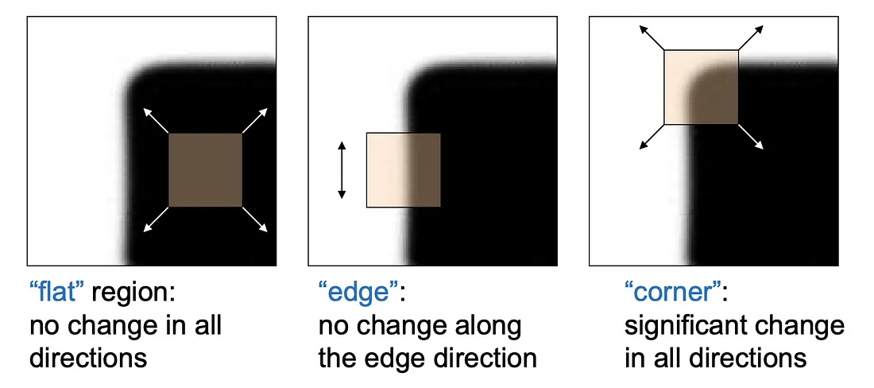
Illustration in three regions

Slide 8

Harris Detector
The corners are regions with a large variation in intensity between pixels in all directions. The Harris detector measures the difference between the original pixel intensity and the intensity after shifting by some amount (u,v):
where I(x, y) is the intensity of a pixel and w(x, y) is the weighting function.

Slide 9
Weighting function
The weighting function w(x,y) ensures that nearby pixels contribute more to the calculation than distant ones.
For example,
In a window around a corner, the central pixels have a larger impact on the computation due to the weighting function, making detection more precise.

Slide 10


The general formula for a first-order Taylor approximation of a function f(x) at x+u is:
Applying this to image intensity I(x,y), we expand it around (x,y):
Ix=∂I/∂x (gradient in x-direction)
Iy=∂I/∂y(gradient in y-direction)

Slide 11


The expression simplifies to:
Replacing I(x+u,y+v) in the equation:
After replacing:

Slide 12



Expanding:
We express this in matrix form:
where M is the second moment matrix

Slide 13
How the second moment matrix detects the corner
The second moment matrix M plays a crucial role in detecting corners by analyzing intensity variations in an image.
In vertical edges, Iy=0 because pixel intensity does not change along the vertical direction.
In horizontal edges, Ix=0 because intensity remains constant along the horizontal direction.
In flat regions, both Ix and Iy are zero, meaning no intensity variation.
Since IxIy=0 in these cases, the matrix M becomes diagonal, meaning the non-diagonal elements vanish.

Slide 14

The matrix M can be diagonalized as:
where:
λ1 and λ2 are the eigenvalues of M.
The eigenvalues represent the strength of intensity variations in different directions.
The eigenvectors define the principal directions of intensity change.

Slide 15
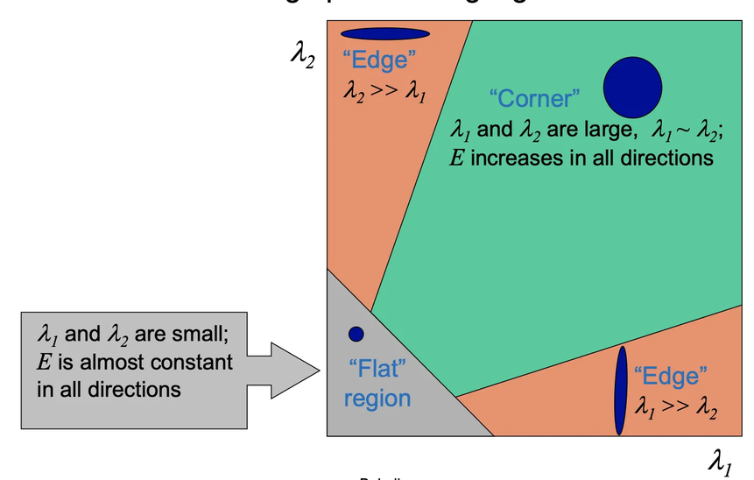
APPROACH FOR CORNER DETECTION
If both eigenvalues are large, the pixel is a corner (strong variation in multiple directions).
If one eigenvalue is large and the other is small, the pixel is an edge (variation in only one direction).
If both eigenvalues are small, the pixel is in a flat region (no significant variation)

Slide 16
CORNER RESPONSE FUNCTION
Corner: R>>0 → Strong variation in multiple directions.
Edge: R≈0 but negative → Variation in only one direction.
Flat Region: R≈0 approx 0 and small → No significant variation.

Slide 17
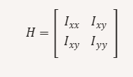

HESSIAN DETECTOR
The basic ideas of detecting corners remain the same as the Harris detector, the Hessian detector makes use of the Hessian matrix and determinant, instead of second-moment matrix M and corner response function R, respectively.
The entries in the Hessian matrix are the second derivatives.

Slide 18

Rotation Invarient
The second moment matrix M is symmetric, meaning it satisfies:
A symmetric matrix can always be orthogonally diagonalized, meaning we can rotate the coordinate system to align with the principal directions of intensity change.
This allows M to detect corners regardless of their orientation.

Slide 19
Not a scale Invarient
Once a corner gets magnified and becomes bigger than the size of the window by zooming, the Harris and Hessian can no longer detect the corner. It is because what the detectors perceive through the window is not a corner anymore but an edge due to the scale change.
In order to overcome this limitation, a number of researches have been performed to create scale-invariant feature detectors.

Slide 20
THANK YOU
2023510044

